Slide 1
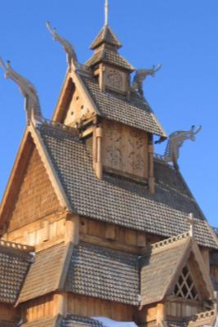
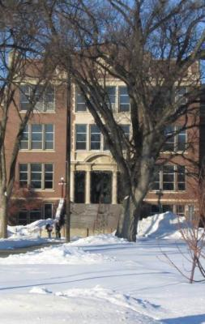
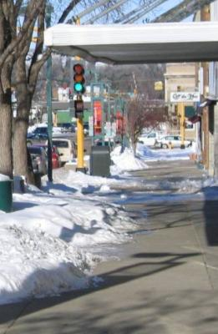
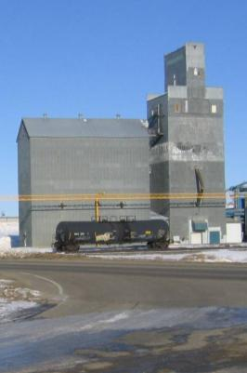
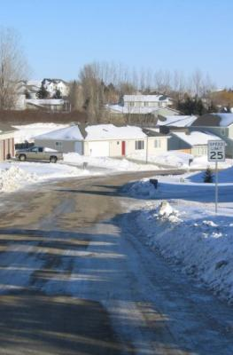
City of Minot
Comprehensive Plan
Steering Committee
December 12, 2011

Slide 2
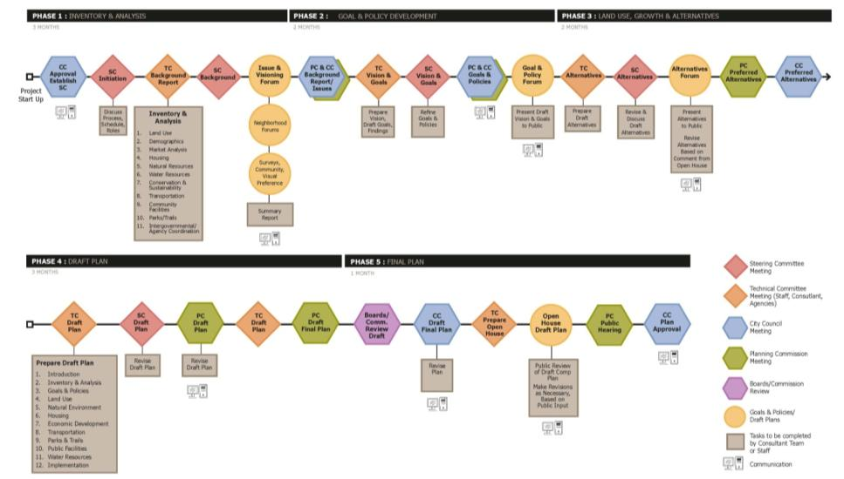
Planning Process
We are in the Alternatives phase, Phase 3 of 5 phases
Each phase includes opportunities for review by the community, Steering Committee, Planning Commission, and City Council
The Plan will be completed by the middle of 2012

Slide 3
Five Key Elements
Minot Master Plan
Revitalized Downtown
Greenway Connections
Compact Development
Housing Opportunities
Transportation

Slide 4
Five Key Elements
1) Revitalized Downtown
Keep the “heart” of Minot strong
Connect downtown to the River and to the Park/Trail system
Focused redevelopment, especially housing, based on market demand
Address parking – ramp, surface, street
Streetscape enhancements

Slide 5
Five Key Elements
2) Greenway Connections
Protect and enhance drainage corridors
Provide amenity
Connect major destinations with biking/walking routes
Provide active living choices
Connect wildlife habitat
Enhance existing streets

Slide 6
Five Key Elements
3) Compact Development
Continue efficient, economical development pattern
Provide services near all neighborhoods
Encourage walking, biking, active living
Reduce car trips
Extend infrastructure in a cost-effective, staged plan

Slide 7
Five Key Elements
4) Housing Opportunities
Ensure “life cycle” housing opportunities for all
Encourage compact development to keep housing costs lower
Look for redevelopment sites
Provide opportunities for new housing in or near downtown

Slide 8
Five Key Elements
5) Transportation
Develop and maintain a safe efficient roadway system
Create a network of connections vs. closed, dead-end streets/plats
Improve north-south connections
Integrate pedestrian/bicycle trails
Provide improved rail crossings or overpasses

Slide 9
Why Are Land Use Plans Essential?
Traffic generation
Sewer flows
Water consumption
Stormwater management
Demand for schools
Demand for parks
Demand for fire/ police protection

Slide 10
How We Plan
Natural Features
Steep Slopes
Water
Wetlands
Floodplain
Manmade Features
Roadways
Parks/Trails
Institutional Uses
Commercial Areas

Slide 11
Putting it All Together
Neighborhood Land Use Elements
Greenway Corridors
Roadways
Commercial Areas
Multi-Family
Parks/Trails
¼ mile walk to parks
Rest of the neighborhood is mostly single family

Slide 12
Compact walkable neighborhoods matter
Environment: Cars are a leading cause of air pollution. Feet are zero-pollution transportation machines.
Health: The average resident of a walkable neighborhood weighs 6-10 pounds less than someone who lives in a sprawling neighborhood.
Finances: One point of Walk Score is worth up to $3,000 of value for your property.
Community: Studies show that for every 10 minutes a person spends in a daily car commute, time spent in community activities falls by 10%.
Economics: Compact neighborhoods cost less per acre for infrastructure: roads, sewer, water, parks, etc.

Slide 13
What makes a neighborhood walkable?
A center: Walkable neighborhoods have a center – a main street or a public space.
People: Enough people for businesses to flourish and for public transit to run frequently.
Mixed income, mixed use: Affordable housing located near businesses.
Parks and public space: Plenty of public places to gather and play.
Pedestrian design: Buildings are close to the street, parking lots to the side or rear.
Schools and workplaces: Close enough that most residents can walk from their homes.
Complete streets: Streets designed for bicyclists, pedestrians, and transit.

Slide 14
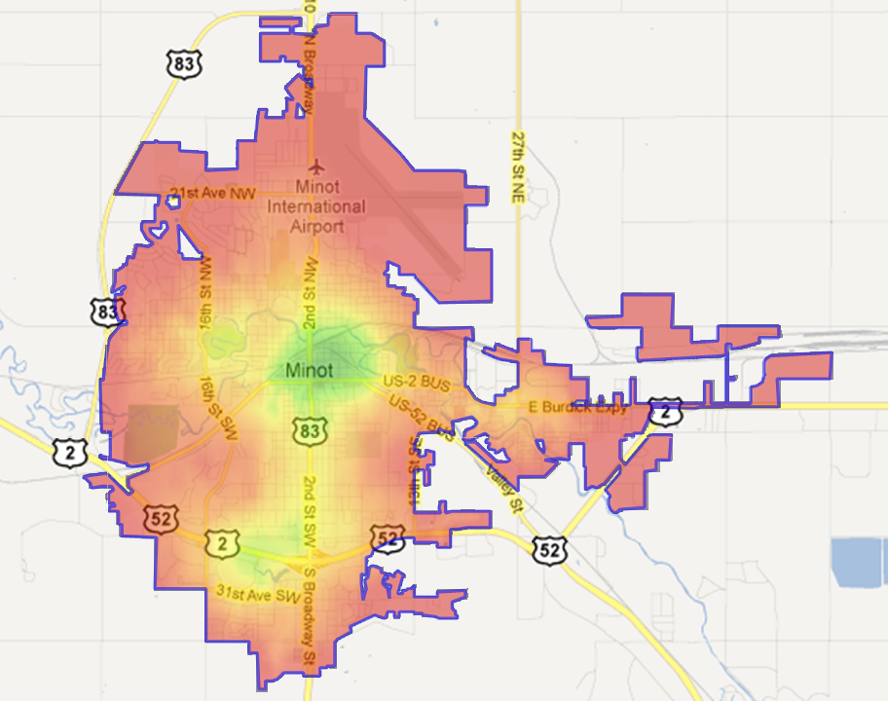

Minot Walk Score
Walk Score Description
90–100 Walker's Paradise —
Daily errands do not require a car.
70–89 Very Walkable —
Most errands can be accomplished on foot.
50–69 Somewhat Walkable —
Some amenities within walking distance.
25–49 Car-Dependent —
A few amenities within walking distance.
0–24 Very Car-Dependent —
Almost all errands require a car.

Slide 15
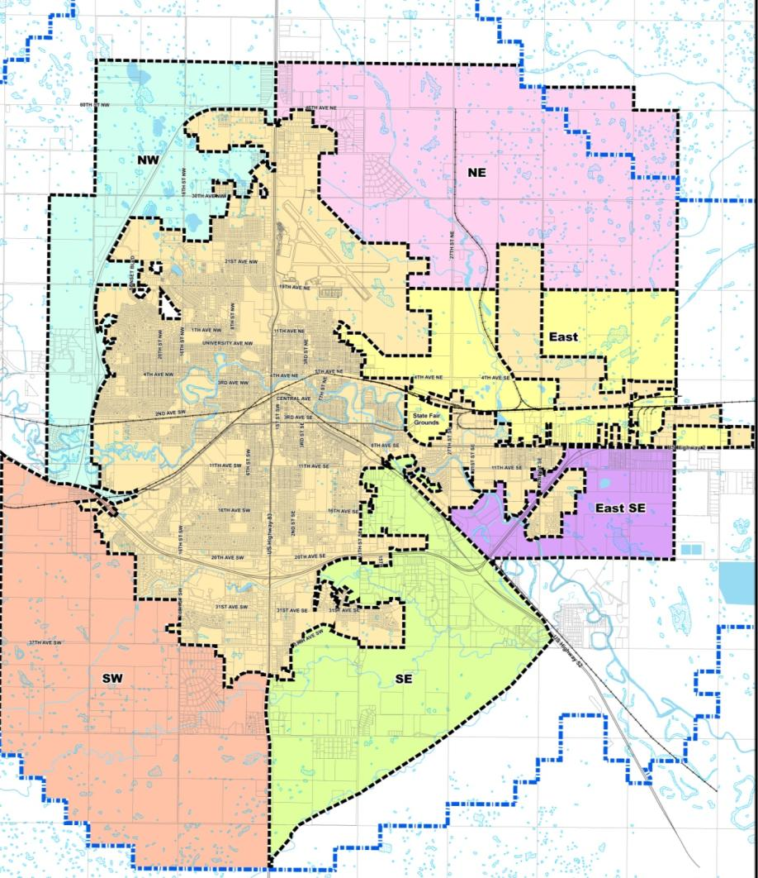
Growth Areas
7 Growth Areas:
Southwest
Northwest
Northeast
East
East SE
Southeast
Downtown

Slide 16
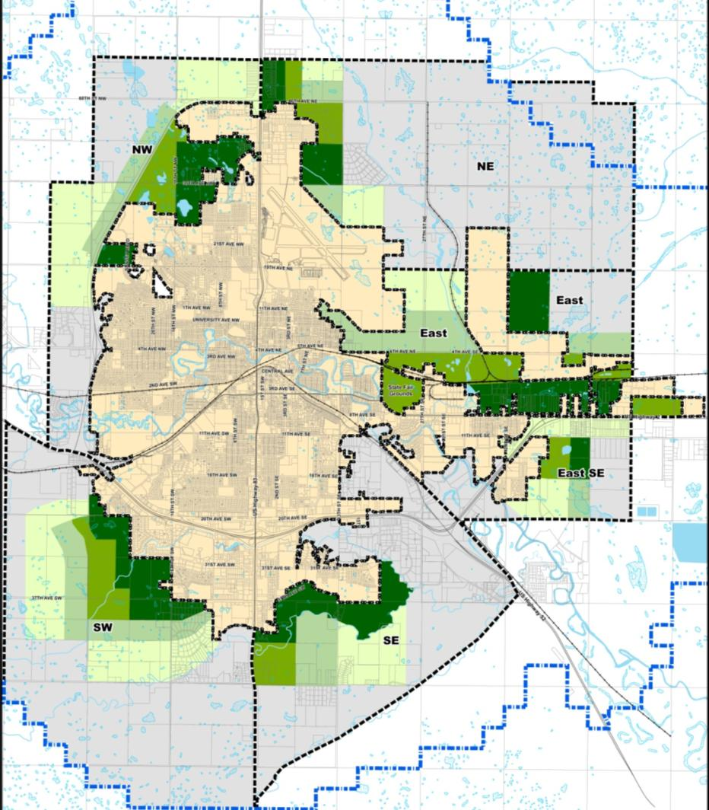
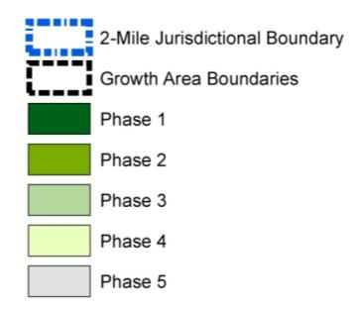
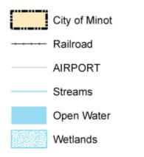
Draft Growth Phasing Plan
Shows potential development in future Growth Areas by phase
Each phase represents 3-10 years of growth
Goal is compact, orderly development

Slide 17
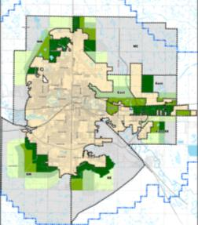
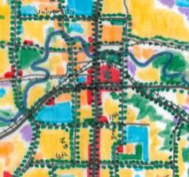
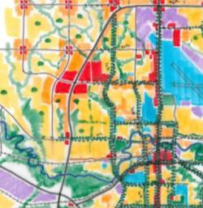
Staged Growth – Principles
Efficiency and cost effectiveness
Sufficient land supply to insure competition and avoid escalating land prices
Clear shared understanding of location and timing of municipal investment, costs and benefits
Fairness

Slide 18
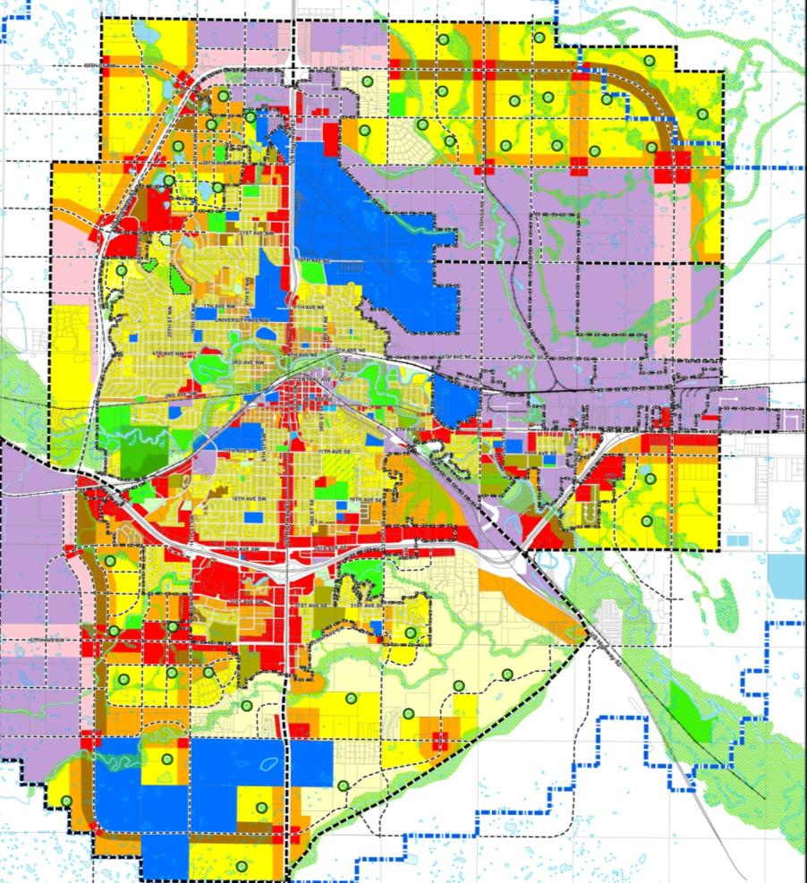
Draft Future Land Use Plan
Shows existing and future City development color code for various land uses
Six Growth Areas (plus Downtown) shown as they are expected to develop
Future roadway system, park system, greenway connections shown

Slide 19

Greenway Connections
While the floods have been personally devastating to many Minot residents and businesses, the Souris Valley Project provides an opportunity to create a lasting benefit to the community – and not just for flood protection
The Comprehensive Plan will incorporate the Souris Valley Project into the overall Plan generally and more specifically with neighborhood plans to be developed later

Slide 20
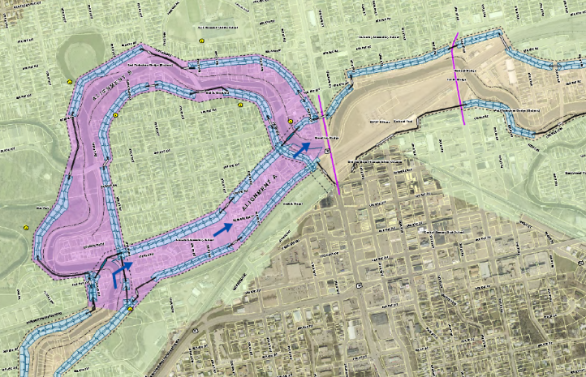
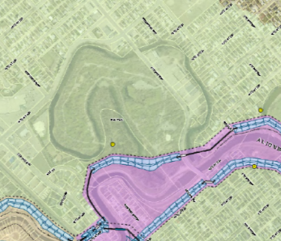
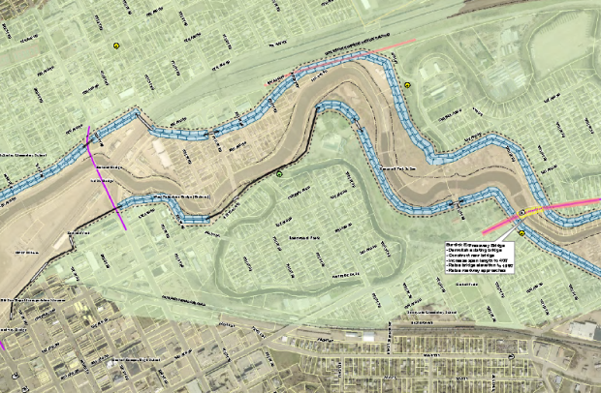
Preliminary Souris River Project
Preliminary plans suggest a new wide Greenway along the river bounded by a wall or dike to contain flood waters
This Greenway creates an opportunity for park and trail connections to and from Downtown to Oak Park and Roosevelt Park and points beyond
Oak Park
Oak Park
Roosevelt Park
Downtown

Slide 21
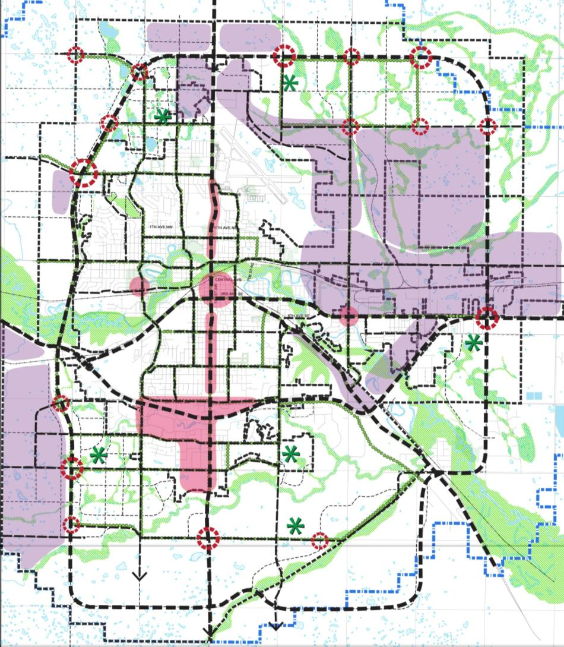
Overall City Concept Plan
The Souris River Greenway provides the main link for park and trail connections throughout the City to existing neighborhoods, parks, and future Growth Areas
Parks, trails, sidewalks and natural features would be integrated into the system
Benefits: stormwater management, active living, wildlife habitat, and amenity

Slide 22
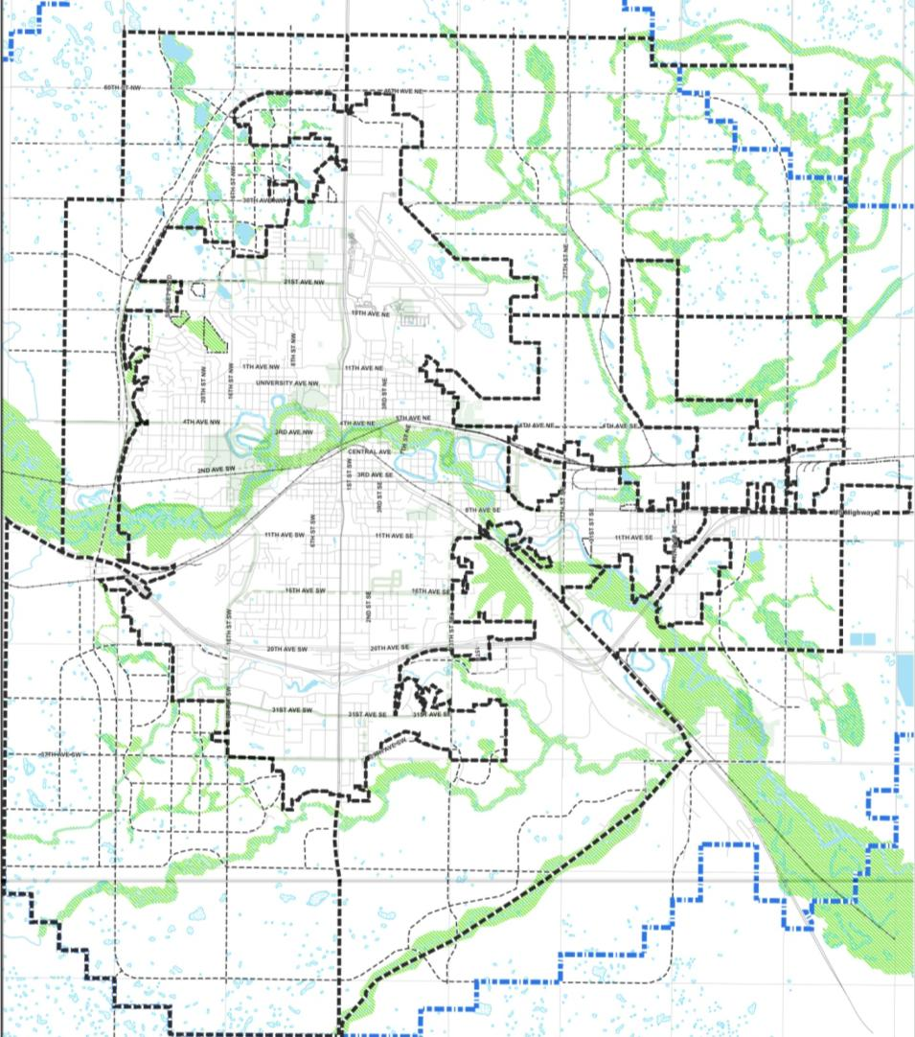
Minot Concept Plan
Start with the existing wetlands, river valley, and coulees
Add the Greenway proposed for the Souris River valley
Together these form the backbone of a “green” connection system for the City

Slide 23
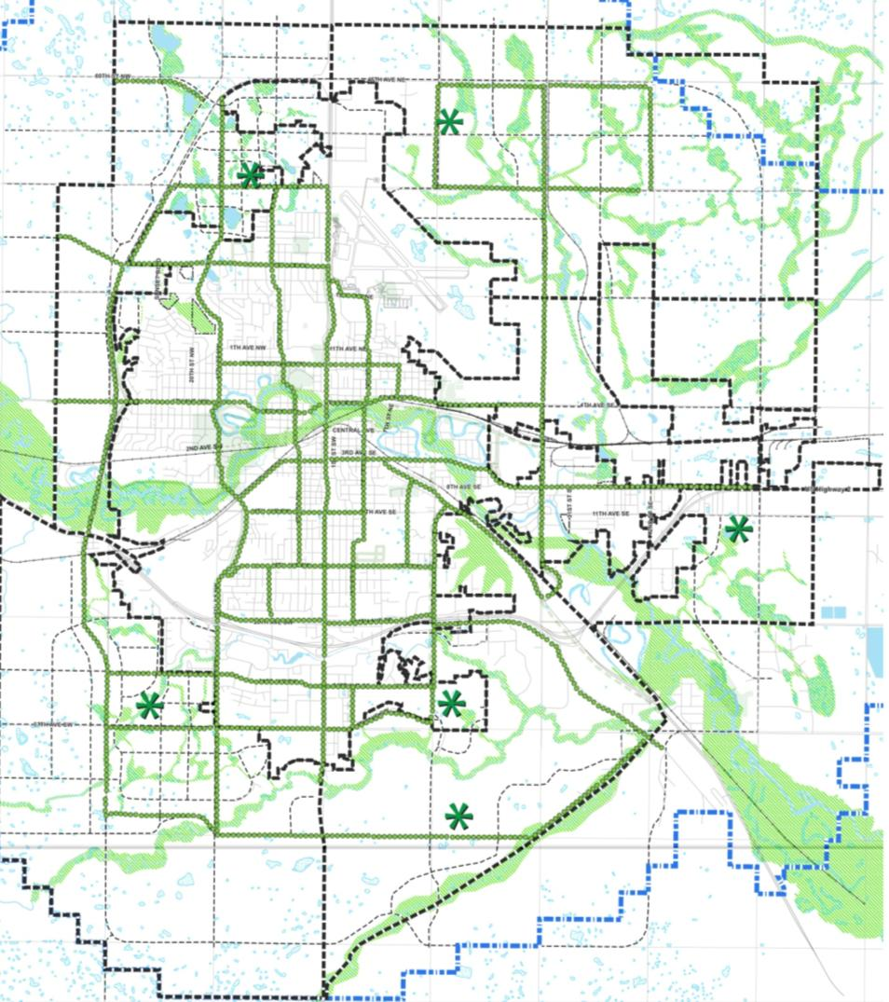
Minot Concept Plan
Add the existing park and trail system
Add new parks and trails in growth areas at the edges of the City and in redeveloping areas inside the existing City

Slide 24
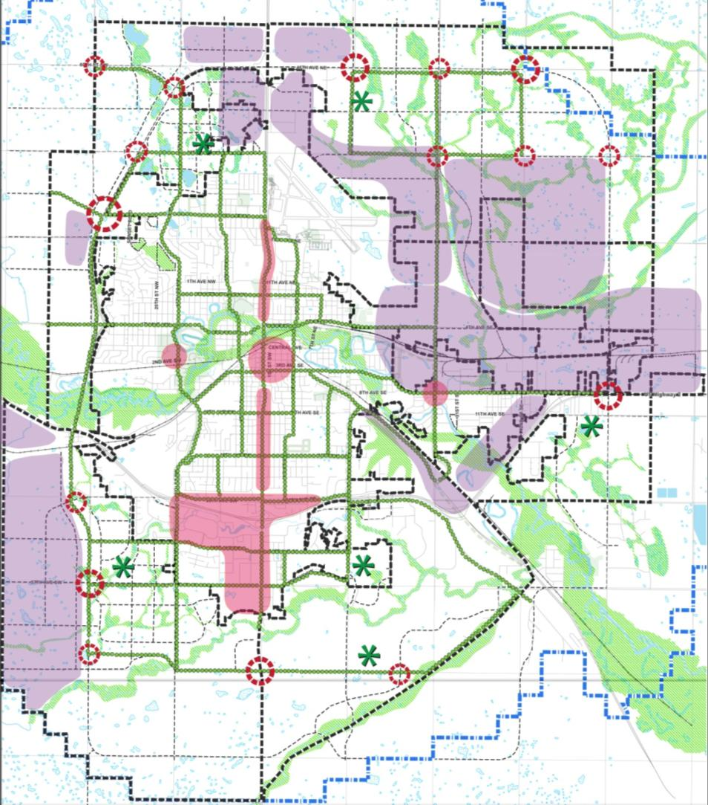
Minot Concept Plan
Add the existing and future major Commercial and Industrial areas

Slide 25
Minot Concept Plan
Add the existing and future major roadways to complete the Concept Plan for the future of Minot
Includes potential new Ring Route around SW and SE Minot, similar to West Bypass and NE Bypass

Slide 26
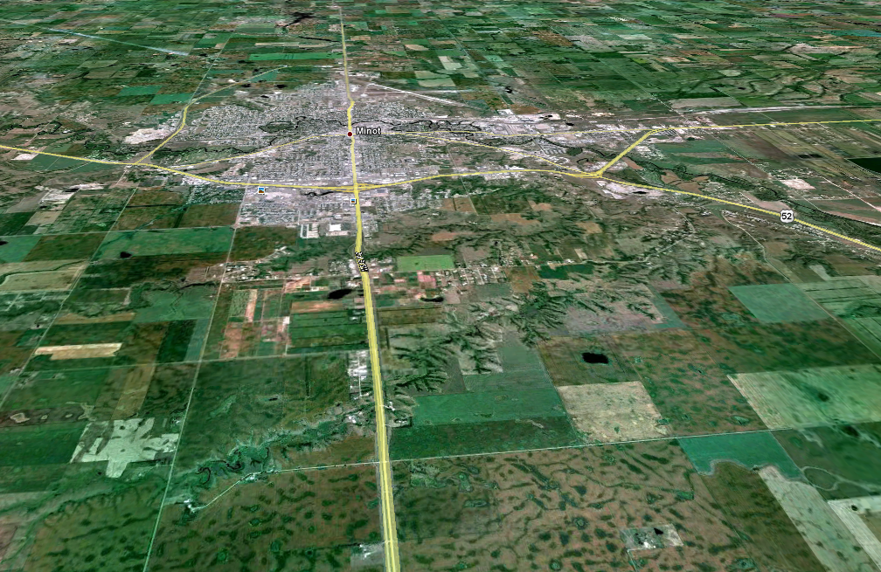
Minot Ring Route Expansion
West Bypass
NE Bypass
55th St SE
54th Ave SE – previous plan
30th St SW
42nd St SE
66th Ave SE
66th Ave SW
Possible SW & SE Ring Route

Slide 27
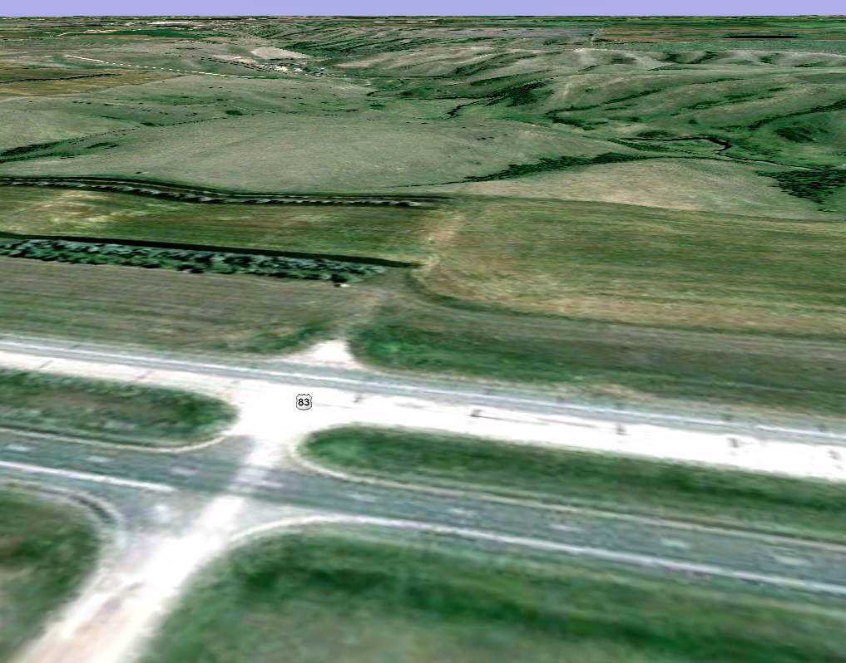
66th Ave E of 83 looking east toward 2nd Larson Coulee – crossing challenging but possible
66th Ave SW

Slide 28
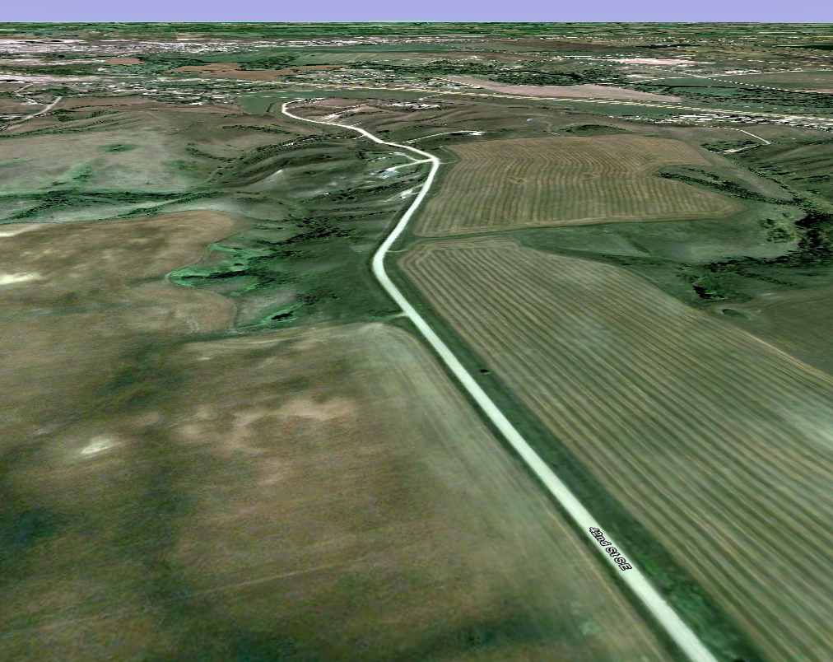
US 52
42nd St SE looking N to US 52 – part of possible Ring Route connection from 66th Ave SE across 52 and Souris River
42nd St SE

Slide 29
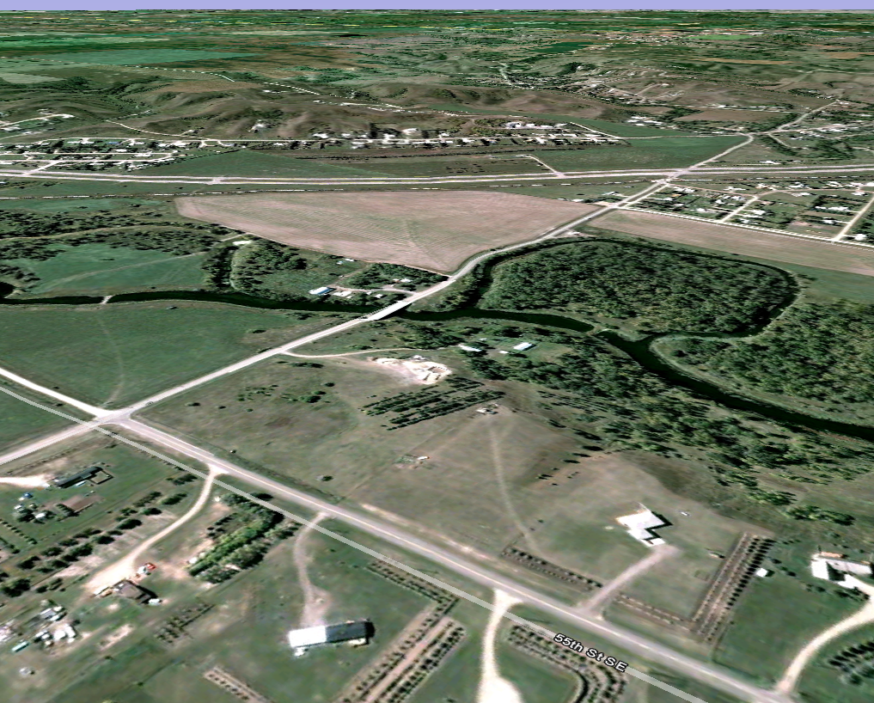
US 52
Approx. Flood Inundation
Approx. Mouse River Project Limits
37th Ave SE either side of Souris River looking SW – connecting 55th St SE (extension of NE Bypass) across Hwy 52 to extension of 66th Ave SE
37th Ave SE
55th St SE

Slide 30
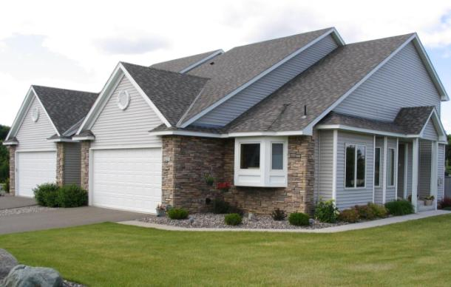
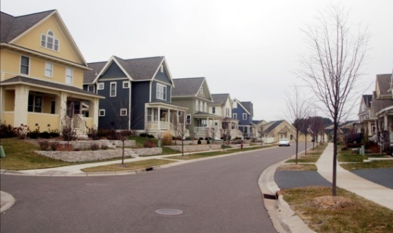
Very Low Density Residential
Land Use Map Color
Building type: Detached and attached single-family homes
Density (or net density): 2-3 units per acre
For areas challenged by slopes and terrain where efficient development and density is not feasible

Slide 31
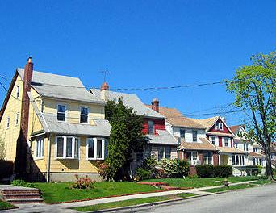

Low Density Residential
Land Use Map Color
Building type: Detached and attached single-family homes
Density (or net density): 4-6 units per acre
For most of Minot’s new neighborhoods

Slide 32
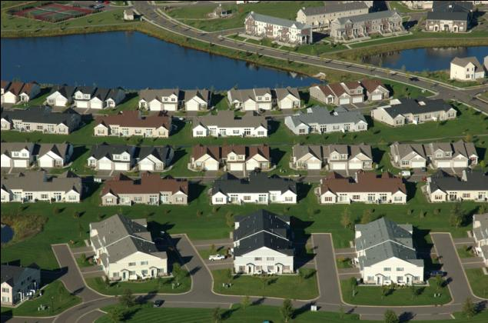
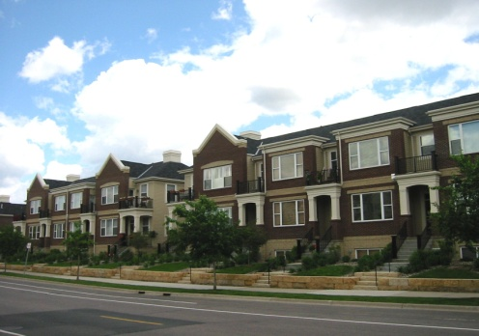
Medium Density Residential
Land Use Map Color
Building type: Twin/Townhome, multiplex, rowhouse
Density (or net density): 6- 12 units per acre
Best land use for creating compact, walkable neighborhoods

Slide 33
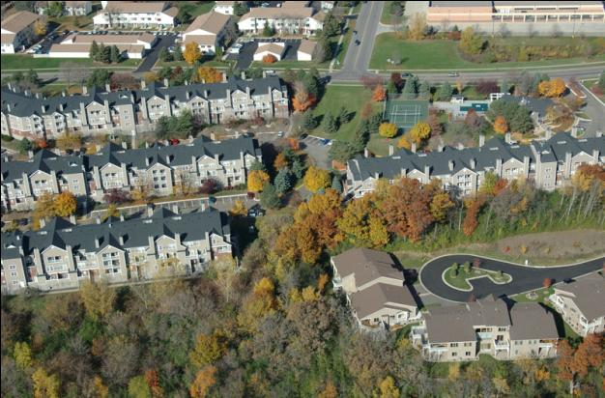
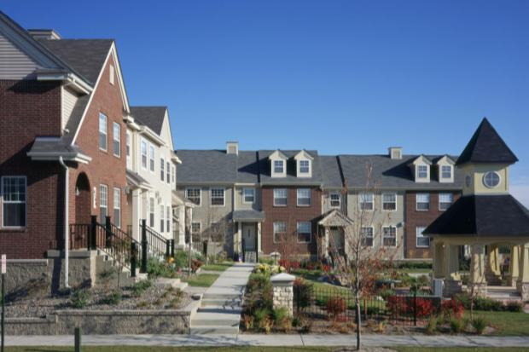
High Density Residential
Land Use Map Color
Building type: Multiplex, Low- or High-rise Apartment Building, Condominium
Density (or net density): 12-24 units per acre and greater

Slide 34
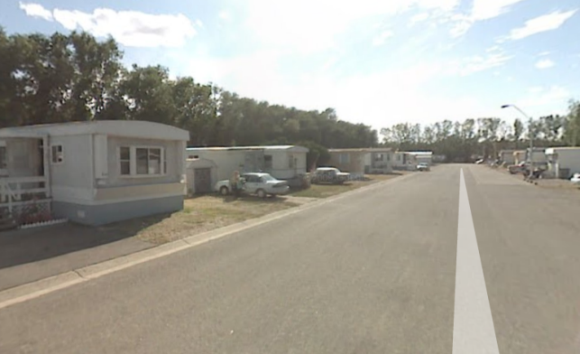
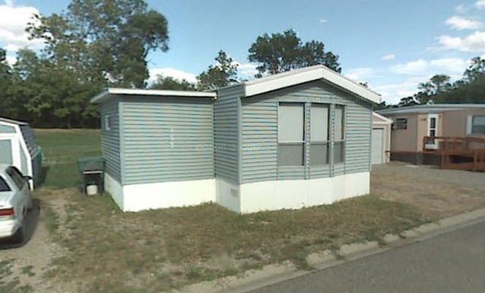
Manufactured Home Park
Land Use Map Color
Building type: Mobile homes, trailers, for existing parks only, no new parks shown
Density (or net density): 4-8 units per acre

Slide 35
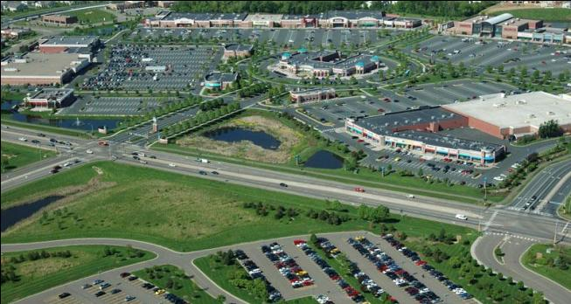
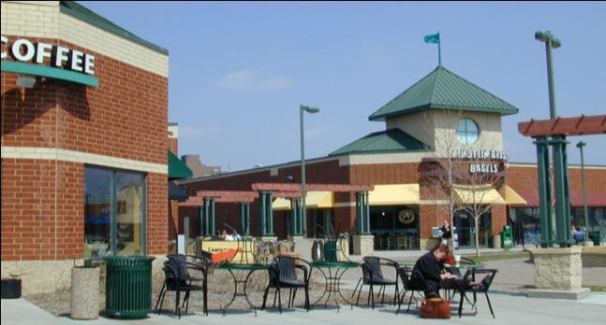
Commercial - regional, highway or neighborhood oriented
Land Use Map Color
Regional and highway-oriented supports uses such as fast food restaurants, convenience stores, gas stations, big box retail, and other auto-oriented businesses, and have a regional draw.
Neighborhood commercial supports such uses as a small grocery or convenience store, coffee shop/deli, personal and health type services. The site and architecture design should be of small scale and compatible with the surrounding uses

Slide 36
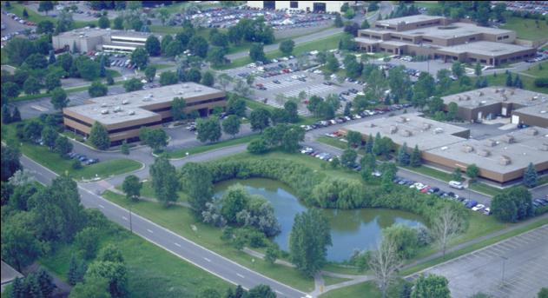
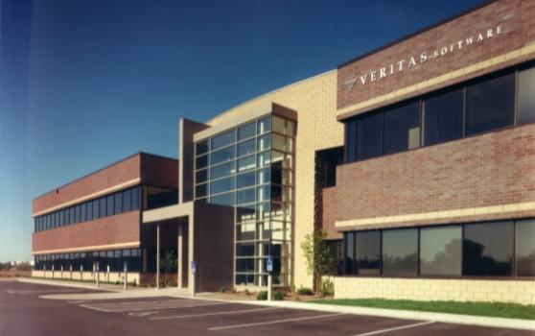
Office Business Park
Land Use Map Color
Supports uses such as office space, light industrial uses, warehousing, research and high-tech manufacturing. Less intense than industrial with no outdoor uses or storage.
Standards requiring high quality, attractive building materials, landscaping and site design standards are an important consideration.

Slide 37
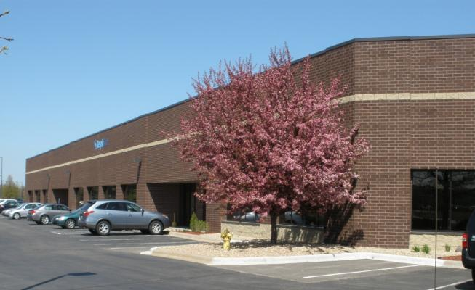
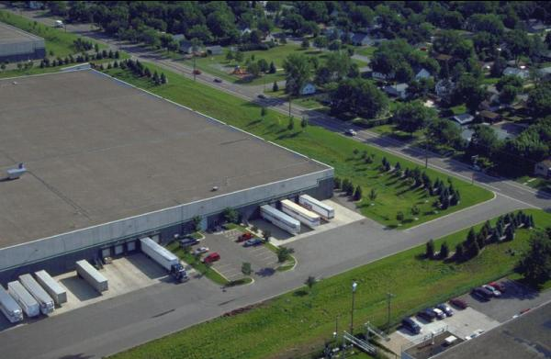
Industrial
Land Use Map Color
Supports uses such as manufacturing, warehousing, automotive, office and other related industrial uses. Could include outdoor storage.
Due to potential impacts such as traffic, noise, and dust; uses typically are not as compatible with residential uses or some commercial uses

Slide 38
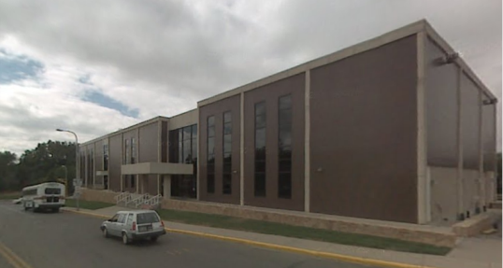
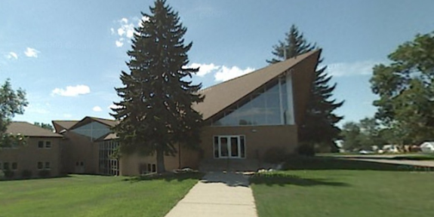
Public/Semi Public
Land Use Map Color
Areas used for the benefit of the public:
  Schools
  City and County Government buildings,
  Utility/infrastructure related uses such as sewage treatment plants, power plants, etc..
Also includes semi-public use/private institutional uses:
  College, religious institutions

Slide 39
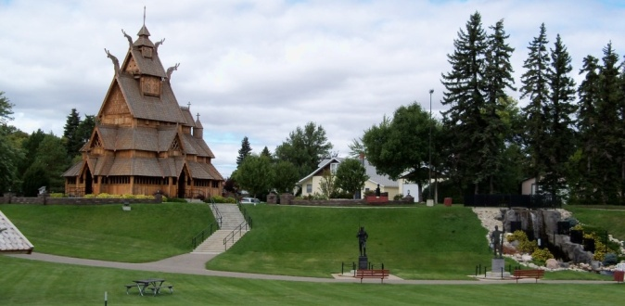
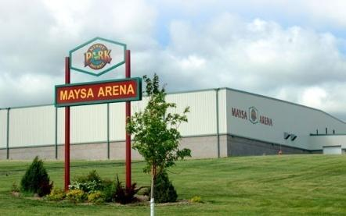
Parks and Open Space
P
Designates existing parks and open space areas and general location for future community parks and playfields.

Slide 40
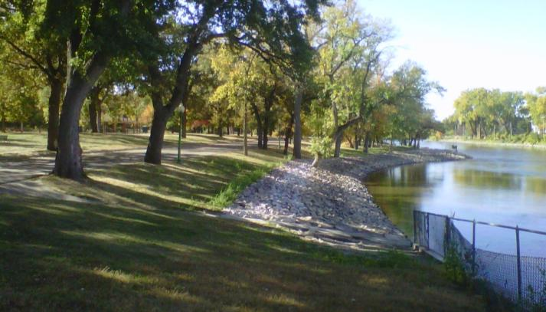
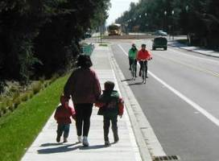
Conceptual Park and Greenway Connections
Natural and manmade areas that serve as connecting spaces for parks & trails, recreation, stormwater, wildlife, and general amenity. No significant buildings or development

Slide 41
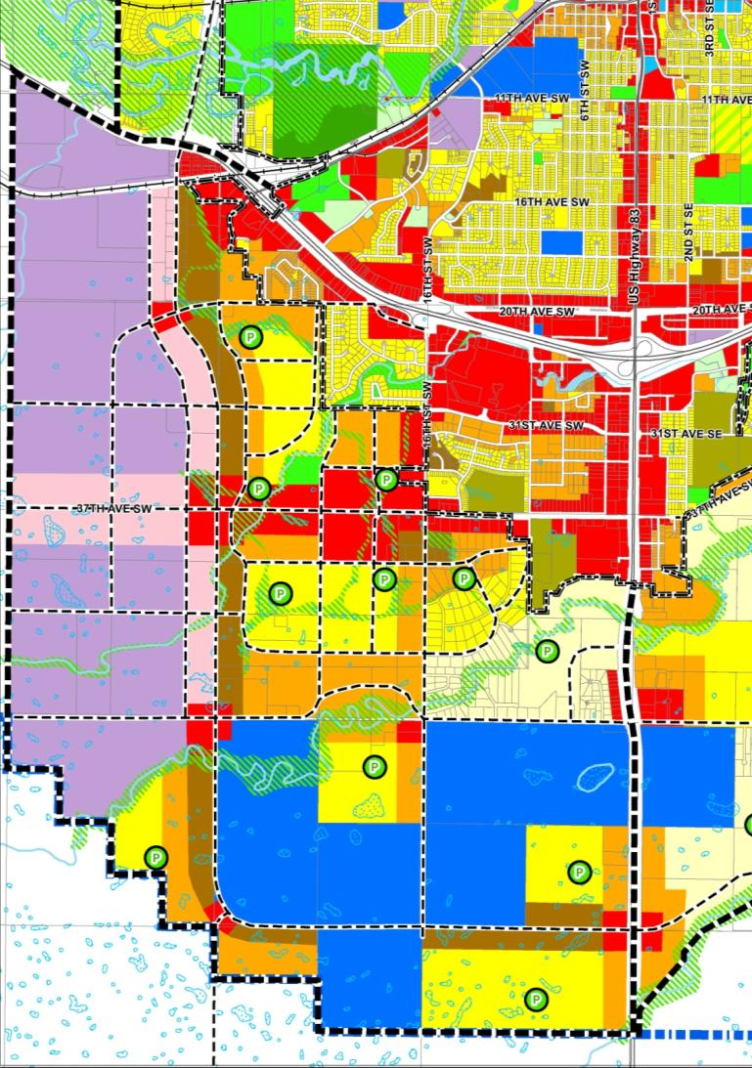
SW Growth Area
Preserve ROW for future Ring Route – 30th Street to 66th Ave
Business Park vs. Industrial on Ring Route
Need large Community park and neighborhood parks
Major commercial node at 37st Ave SW and 30th Street
Create compact, walkable neighborhoods
Control land use outside of Ring Route
1st Phase: +3,500-6,500 pop.
Ultimate: +26,000-49,000 pop.

Slide 42
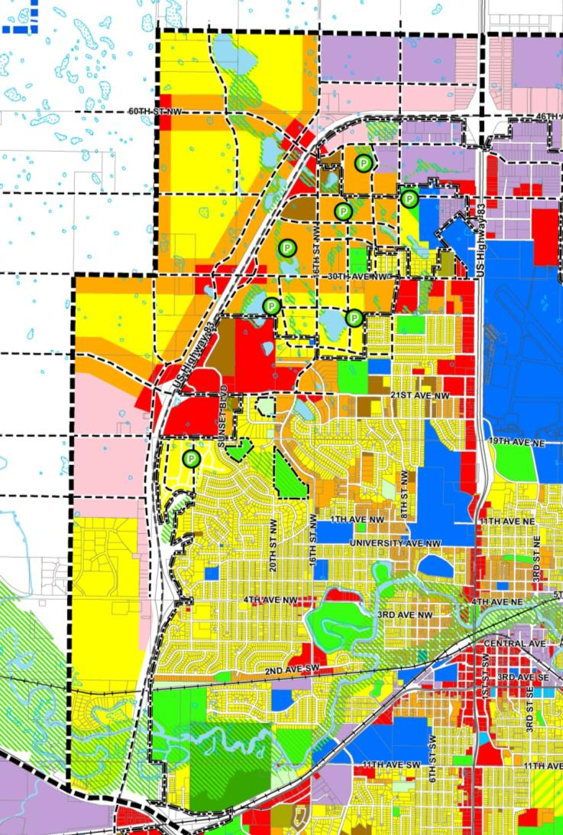
NW Growth Area
16th Street & 8th Street as connecting arterials
Connect frontage roads either side of West Bypass
Major commercial node at 21st Ave NW and Bypass
Need large Community park and neighborhood parks
Control land use outside of Bypass
Create compact, walkable neighborhoods
Phase 1: +3,000-6,000 pop.
Ultimate: +18,000-32,000 pop.

Slide 43
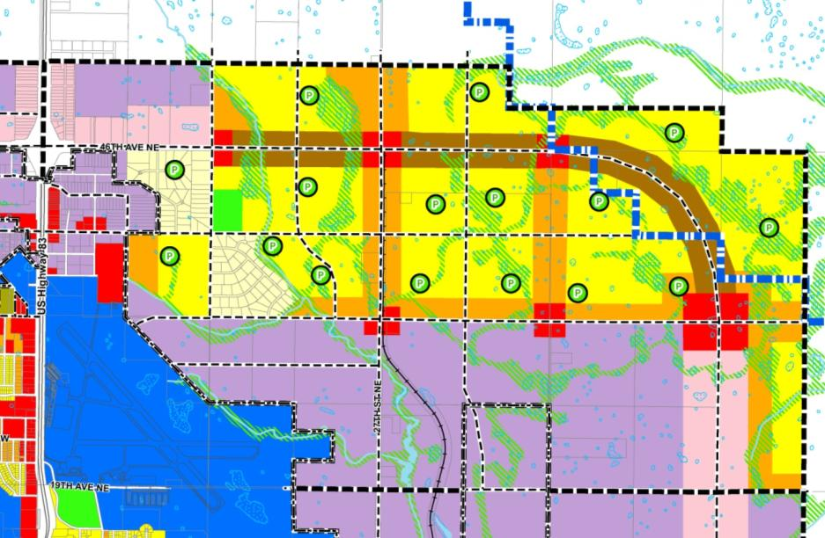
NE Growth Area
Provide arterial access to Industrial on NE side of airport
Potential conflict – Residential vs. Industrial unless carefully planned
Business Park along 46th Avenue Bypass
Need Community park & neighborhood parks
Livingston Creek greenway
Compact, walkable neighborhoods
Phase 1: +1,200-2,100 pop.
Ultimate: +36,000-64,000 pop.

Slide 44

East Growth Area
Significant Industrial opportunity on RR hub
Provide access to airport and Minot AFB via new 55th Street/ NE Bypass

Slide 45

East SE Growth Area
Current FEMA site
Future residential growth
Future extension of 55th Street Bypass
Some areas impacted by flood project
Phase 1: +800-1,300 pop.
Ultimate: +4,700-8,000 pop.

Slide 46

SE Growth Area
Mostly Residential – limited by topography, coulees
Recreational opportunities with hills, coulees
Need large community park & neighborhood parks
Create compact, walkable neighborhoods
Potential future Ring Route along 66th Ave SE to 42nd St SE
13th St arterial connector
Phase 1: +2,600-4,300 pop.
Ultimate: +23,000-39,000 pop.

Slide 47


Downtown
Heart of the community
New park and open space on River Greenway connects Downtown to Oak Park, Roosevelt Park
Encourage new Residential development
Greenway connections
Downtown parks/squares
Needs additional studies of parking, land use, streetscape, infrastructure
Potential: +500-1,000 units, +1,000-2,000 pop.

Slide 48

V3 Studio Potential Residential Projects

Slide 49

V3 Studio Potential Residential Project

Slide 50

V3 Studio Potential Residential Project

Slide 51

V3 Studio Potential Residential Projects

Slide 52
Growth/Phase Projections
Additional Growth:
Phase 1:
    5,000-9,000 units
    11,000-20,000 pop.
  Phase 2:
    4,000-7,500 units
    9,000-16,000 pop.
  Phase 3:
    3,000-5,000 units
    6,500-11,000 pop.
  Phase 4:
    6,000-11,000 units
    13,500-24,000 pop.
  Phase 5:
    31,000-55,000 un.
    70,000-120,000 p.
  Total:
    49,000-87,000 units
    109,000-193,000 p.
  City: 150,000-240,000 pop.

Slide 53
Growth/Phase Projections
Total Minot Population - Cumulative Growth:
Phase 1:
    55,000-67,000 pop.
  Phase 2:
    64,000-84,000 pop.
  Phase 3:
    70,000-95,000 pop.
  Phase 4:
    84,000-119,000 p.
  Phase 5:
    150,000-240,000 p.

Slide 54

Growth/Total Estimate
Ultimate Population in Growth Areas: (estimated):
  Minot: 150,000-240,000 pop.
  Similar to:
    Madison, WI
    Spokane, WA
    Boise, ID
    Des Moines, IA
    Orlando, FL
    St. Paul, MN (almost)
  Plan Carefully

Slide 55
Discuss Plan & Growth Areas
NW & NE Growth Areas
Divide into small groups around each of three tables.
Discuss the proposed Growth Area Land Use Plan map – North, South and East areas – and make comments, suggestions, changes
Move to the next table and do the same.
East Growth Areas & Downtown
SW & SE Growth Areas

Slide 56
City of Minot
Comprehensive Plan
Questions/ Discussion

Slide 57
City of Minot
Comprehensive Plan
Growth Potential

Slide 58
Growth/Phase Projections
Additional Growth:
Phase 1:
    5,000-9,000 units
    11,000-20,000 pop.
  Phase 2:
    4,000-7,500 units
    9,000-16,000 pop.
  Phase 3:
    3,000-5,000 units
    6,500-11,000 pop.
  Phase 4:
    6,000-11,000 units
    13,500-24,000 pop.
  Phase 5:
    31,000-55,000 un.
    70,000-120,000 p.
  Total:
    49,000-87,000 units
    109,000-193,000 p.
  City: 150,000-240,000 pop.

Slide 59
Growth/Phase Projections
Total Minot Population - Cumulative Growth:
Phase 1:
    55,000-67,000 pop.
  Phase 2:
    64,000-84,000 pop.
  Phase 3:
    70,000-95,000 pop.
  Phase 4:
    84,000-119,000 p.
  Phase 5:
    150,000-240,000 p.

Slide 60
Growth/Total Estimate
Ultimate Population in Growth Areas: (estimated):
  Minot: 150,000-240,000 pop.
  Similar to:
    Madison, WI
    Spokane, WA
    Boise, ID
    Des Moines, IA
    Orlando, FL
    St. Paul, MN (almost)
  Plan Carefully

